Slide 1
Statutory Regulation for Traditional Chinese Medicine in the UK
15 years’ progress but still no outcome
Dr Hui Jun Shen
Vice President
The Association of Traditional Chinese Medicine and Acupuncture UK

Slide 2
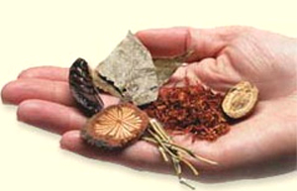
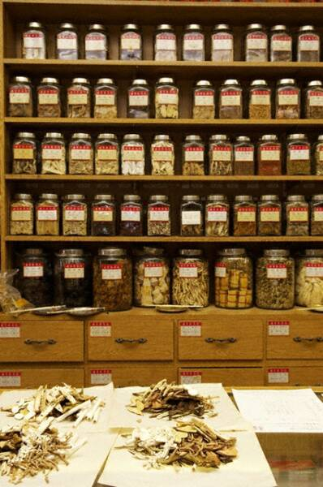
Outline
TCM in the UK
TCM regulation in the UK
  HoL Report and two regulatory working groups
  (2000-03)
  First DH Consultation (2004)
  From CAM Council to HPC (2005)
  Joint Steering Group (2006-07)
  Second DH Consultation (2008)
  DH Official Announcement on SR (Feb 2011)
  Change of idea by DH New Minister (Sept 2012)
  Third Round of Working Group & Walker Report (Dec 2013 – Nov 2014)
  Under New Government & Brexit: U-turn or Go-ahead with SR

Slide 3
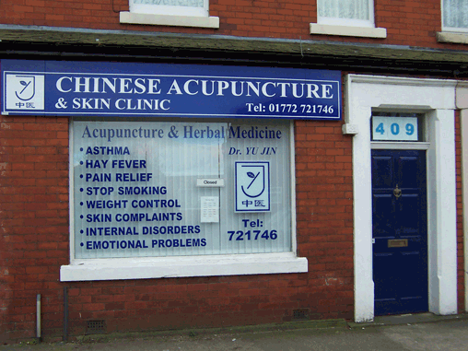
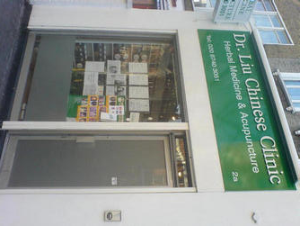
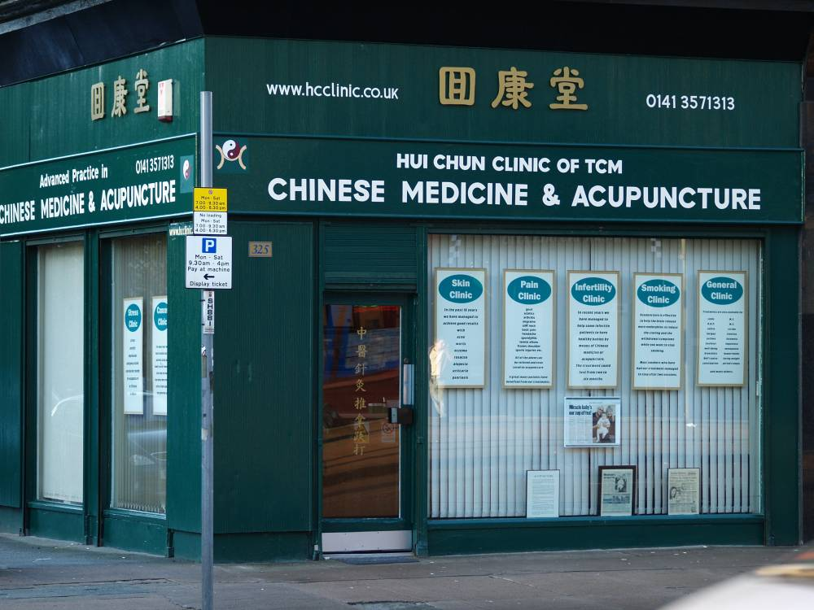
1. TCM in the UK
Notes:
3

Slide 4
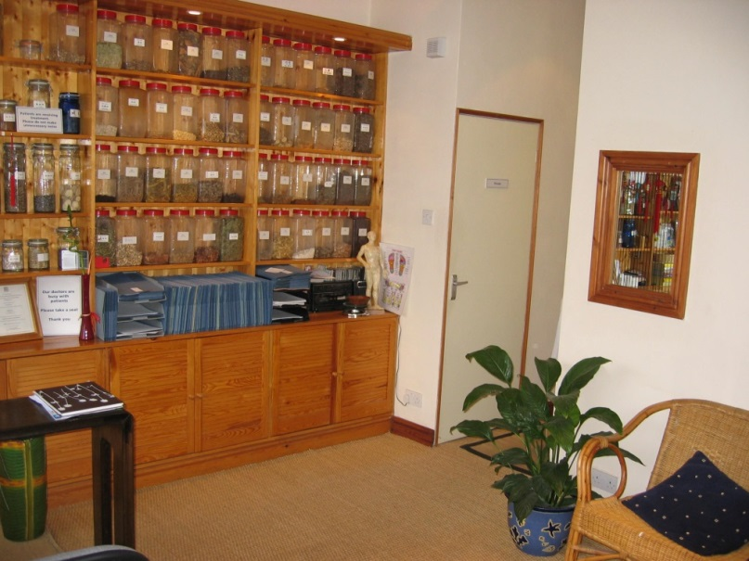
Rapid growth since early 1990s.
Largest TCM profession in Europe
Approx 2500 TCM practitioners- Chinese and British
In addition, over 4000 traditional acupuncturists
Increasingly accepted by UK public in last 20 years
Second largest profession of UK Chinese community

Slide 5
Problems troubling TCM
Lack of statutory regulation, self regulation often powerless
Anyone can claim to be a TCM practitioner and practise legally!
Unqualified or under-qualified “ practitioners” – a great risk to the safety of the public.
Negative incidents happen from time to time
  Aristolochia crisis (1999-2001)
  Old Bailey case February 2010
Some TCM businesses pursuing commercial interest without professional ethics

Slide 6

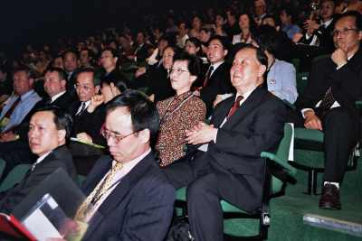
About ATCM
The Association of Traditional Chinese Medicine and Acupuncture UK www.atcm.co.uk info@atcm.co.uk
Founded in 1994
Over 700 members
Largest TCM organisation in the UK
BSc degree qualification or equivalent
Similar standards as TCM doctors in China
Key speaker to UK government on statutory regulation for TCM
Notes:
6

Slide 7

2. TCM regulation in the UK
  House of Lords Report (2000)
  Two regulatory working groups (2002-03)
  First DH Consultation (2004)
  From CAM Council to HPC (2005)
  Joint Steering Group (2006-07)
  Second DH Consultation (2008)
  Official Announcement by DH (Feb 2011)
  Standstill since Sept 2012
  Third round of working group by DH (12/2013-11/2014)
    Walker Report
  U-turn or Going ahead?

Slide 8
Outline of 15 Years TCM Regulation
Year 2000----House of Lords report on Complementary and Alternative Medicine
Year 2002----The government set up two regulatory working groups for herbal medicine and acupuncture
Year 2004----Frist DH consultation to recognise TCM’s integrity and TCM regulation in CAM Council
Year 2006---Steering Group founded to regulate Acupuncture, Herbal Medicine and TCM with HPC (as suggested by DH)
Year 2008---Second consultation supporting SR with HPC
Year 2010---UK government abandon SR, offering regulation with CNHC-non SR body
Year 2011---Government came back to SR and re-offered HPC
Year 2012---New minister, new idea.
Year2013-15 Third round of working group, Walker Report
Year 2016 – New government, Brexit, U-turn or go-ahead on SR?
Notes:
8

Slide 9
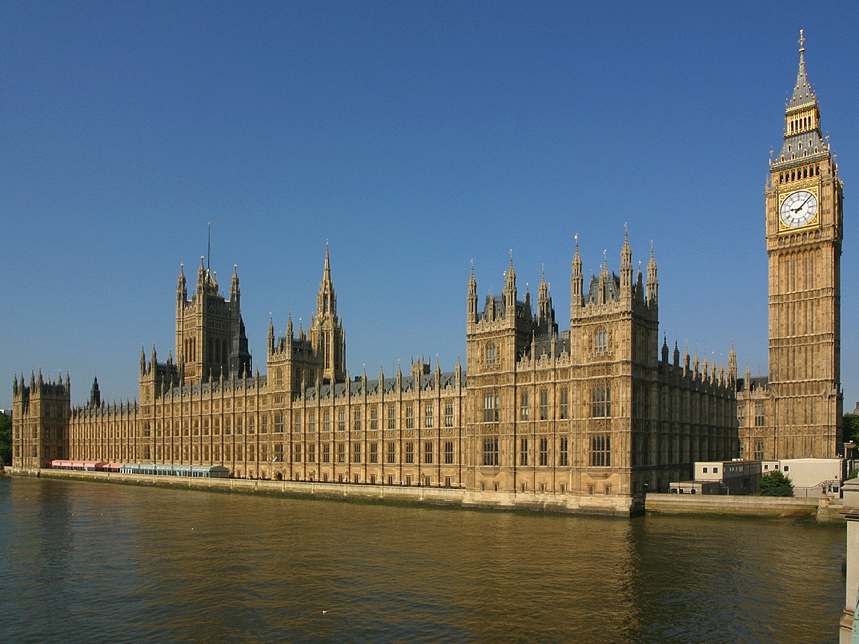
1). House of Lords Report to the Two Working Groups
(November 2000— September 2003)
In November 2000, the House of Lords Select Committee on Science and Technology published a report on CAM (complementary and alternative medicine).
  Acupuncture and herbal medicine were placed in Group 1 of CAM (Big Five), deemed as more effective and should be regulated first.
  TCM was devalued into Group 3, being considered as less effective and closely linked with philosophy and religion.
The British government (DH) then set up two working groups to start the procedure of regulation for Acupuncture and Herbal Medicine.
  Herbal Medicine Regulatory Working Groups（HMRWG)
  Acupuncture Regulatory Working Group (ARWG)
Notes:
9

Slide 10
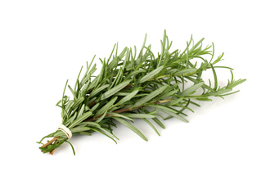
Comparison of two working groups’ reports
(published in September 2003)
HMRWG Report
Proposing CAM Council
Recognizing TCM as a unique entity
Recommending the title protection for TCM practitioners
ARWG Report
Proposing a free-standing acupuncture council
Denying TCM as a unique entity
Opposing the title protection for TCM practitioners
Notes:
10

Slide 11


2). First DH Consultation
(March – June 2004)
Based on the two working groups’ reports, the government then launched the first consultation
The government (DOH) consultation document was published on the 2nd March 2004, followed by a three months consultation period.
Notes:
11

Slide 12
Responses to first DH consultation
Over 700 responses. A “slight” majority of responses were in favour of the government proposal for the establishment of CAM Council.
The idea of separate regulation for acupuncture and herbal medicine has reached to its end.
TCM as an entity should be regulated along side herbal medicine and acupuncture
Notes:
12

Slide 13
ATCM’s Lobby
ATCM hired a PR company DLA to help us lobbying
ATCM’s Briefing Paper was sent to over 100 MPs, Lords and government officers.
ATCM members wrote to the local MPs. Some MPs have given their supportive responses.
The representatives of ATCM met several MPs and Lords in 2004-2005
Our demands were raised at the House of Lords debates, and the DH minister gave a very positive and encouraging response to it.(18th October 2004)
Notes:
13

Slide 14
First and most positive remarks on TCM from UK government
Lord Hunt asked Her Majesty's Government at the House of Lords debate on 18th October 2004:
“Whether the government’s final proposals for the statutory regulation of herbal medicine and acupuncture recognise traditional Chinese medicine as a distinct discipline on an equal standing to herbal medicine and acupuncture and with a separate register.”
Lord Warner, the DH minister in charge of regulation, answered :
“We recognise that many practitioners of traditional Chinese medicine use both herbal medicine and acupuncture. Decisions about any new system of statutory regulation will therefore need to take account of their particular needs.”
Notes:
14

Slide 15

4). From CAM Council to HPC
(March 2005 – May 2006):
Since March 2005:
  General Election
  New DH Ministers
  Shipman Report
DH has modified their thinking over the regulation and CAM Council was no longer an option.
Health Professions Council - The new option on offer: Acupuncture, Herbal Medicine and TCM to join HPC
Notes:
15

Slide 16
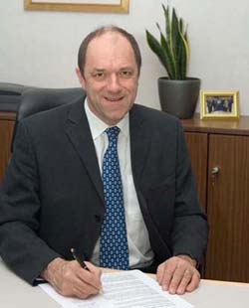
5). Joint Steering Group and its Report
(June 2006 – June 2008)
Steering Group on the Statutory Regulation of Practitioners of Acupuncture, Herbal Medicine, Traditional Chinese Medicine and Other Traditional Medicine Systems Practised in the UK
  Steering Group chaired by Prof Pittilo
  The group was functioning June 2006 – Sept 2007
  Pittilo Report published in August 2008
Notes:
16

Slide 17
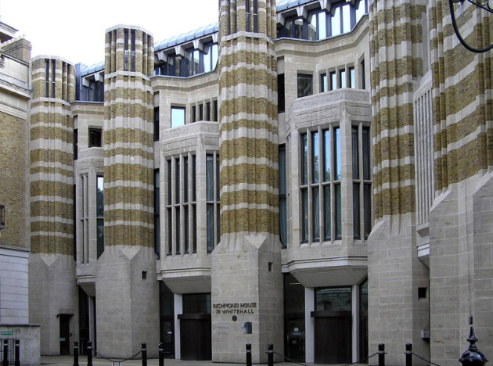
6). Second DH Consultation
(August – November 2008)
3 August 2008, second DH consultation
Statutory Regulation or alternative
Responses to second DH consultation (Not published until Feb 2011)
  Over 6600 responses, vast majority (85%) supporting SR, a small minority (15%) are against SR
  The opposition mainly from mainstream medicine
  Majority support HPC to regulate herbal medicine, acupuncture and TCM together
Notes:
17

Slide 18

7). Idea of non-SR regardless of majority response (April 2010 – April 2012)
A standstill after second consultation
Anti-CAM wave from mainstream medical and scientific groups
On 1st April 2010, DH abandoned SR with HPC, offering CNHC registration
A U-turn from SR by the then government
Notes:
18

Slide 19

ATCM Lobby again and positive responses from key politicians
ATCM continues lobby to parliament candidates
Briefing letter to new government urging for SR
Support from Nick Clegg (now Deputy Prime Minster)
Andrew Lansley (now Health Secretary)
Earl Howe (then shadow health minister and Torry health spokesman, now DH minister)
Notes:
19

Slide 20

On 16th February 2011, DH announced SR for herbal medicine and TCM practitioners with HPC, starting from April 2012
We welcome government’s new decision
Notes:
20

Slide 21
However….
Final goal for 15 years not achieved yet
New DH minister in Sept 2012, change of idea
No clue there will be a final U-turn or Go-ahead
Question on accountability and efficiency of UK government
TCM Regulation in the UK has gone through 15 years, still no outcome
  Work together to achieve the best outcome of TCM regulation
  Promote the development of TCM in the UK and in the world
  Amplify TCM’s role in healthcare
Notes:
21

Slide 22
15 Years Overview
March 2004
Sept
2012
June 2006
February 2011
Nov 2000
April 2010
HMRWG ARWG | 1st consultation | Joint Steering Group 2nd Consultation | Opposition from mainstream DH change mind | Majority support DH re-offer SR | Third Round of working group, Walker Report
Herbal Medicine | CAM Council | HPC (Health Professions Council) | CNHC (Complementary and Natural Healthcare Council) | HPC Again (From April 2012) | ????
Acupuncture
No space for TCM | TCM Accepted | Statutory Regulation | Non-statutory Regulation | Back to Statutory Regulation | U-turn or Go-ahead
Notes:
22

Slide 23
ATCM’s New Lobby to the New Government after Brexit
ATCM Letter to Prime Minister Theresa May
ATCM letter to DH Secretary Jeremy Hunt
  To urge for Statutory Regulation once again
  (August 2016)
  Responses received from 10 Downing Street and DH
  No Promise given.

Slide 24
Thank you!

